Slide 1
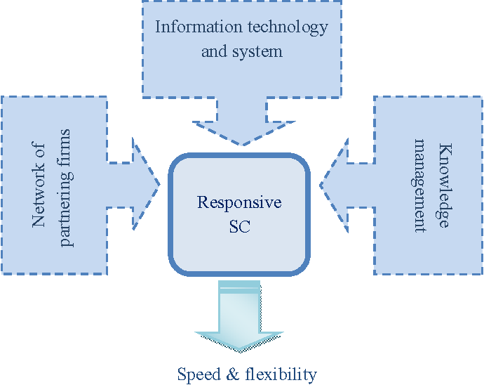
Designing the supply chain Network

Slide 2
Distribution:
Distribution refers to the steps taken to move and store a product from the suppliers stage to a customer stage in the supply chain.
Distribution occurs between every pair of stage in a supply chain.
Raw materials and components are moved form suppliers to manufactures where as finished products are moved from the manufactures to ultimate customer.
Distribution is an important driver of the overall profitability of a firm because it directly impacts both the supply chain cost and the customer experience.

Slide 3
What is the role of distributors?
Distributors play a vital role in smoothly connecting manufactures and customers. They can efficiently response times, enhance a company's reach and even create value added packages that complement a company's product offering or scope.

Slide 4
What is the role of distribution in supply chain?
Physical distribution includes all the activities associated with the supply of finished product at every step, from the production line to the consumers.
Important physical distribution functions include customer service, order processing, inventory control, transportation and logistics, packaging and materials.

Slide 5
Factors Influencing Distribution Network Design
Performance of distribution network should be evaluated along two dimensions;
1. Customer needs that are met ( Customer service)
Response time ( Time it takes for a customer to receive an order.)
Product variety ( number of different products that are offered)
Product availability ( probability of having a product in stock)
Customer experience ( Ease of placing and receiving orders)
Order visibility ( ability of customer to track their orders)
Return ability ( Ease of returning unsatisfactory merchandise)

Slide 6
2. Cost of meeting customer needs ( Supply chain cost)
Inventory ( All raw materials, WIP, and finished goods)
Transportation ( Moving inventory form point to point)
Facility and handling ( locations where product is stored, assembled or fabricated)
Information ( Data and analysis of all drivers in a supply chain)

Slide 7
Factors Influencing Distribution Network Design
Managers must make two key decisions when designing a distribu­tion network:
Will product be delivered to the customer location or picked up from a prearranged site?
Will product flow through an intermediary (or intermediate location)?
Based on the firm’s industry and the answers to these two questions, one of six distinct distribution network designs may be used to move products from factory to customer.

Slide 8
These designs are classified as follows:
1.Manufacturer storage with direct shipping
2.Manufacturer storage with direct shipping and in-transit merge
3.Distributor storage with carrier delivery
4.Distributor storage with last-mile delivery
5.Manufacturer/distributor storage with customer pickup
6. Retail storage with customer pickup

Slide 9
1. Manufacturer storage with Direct shipping
In this option, product is shipped directly from the manufacturer to the end customer, bypassing the retailer (who takes the order and initiates the delivery request).
This option is also referred to as drop-shipping. The retailer carries no inventory. Information flows from the customer, via the retailer, to the manufacturer, and product is shipped directly from the manufacturer to customers.
Online retailers such as eBags and Nordstrom.com use drop-shipping to deliver goods to the end consumer. eBags holds few bags in inventory. Nordstrom carries some products in inventory and uses the drop-ship model for slow-moving footwear. W.W. Grainger also uses drop-shipping to deliver slow-moving items to customers.

Slide 10
2. Manufacturer Storage with Direct Shipping and in-Transit Merge
Unlike pure drop-shipping, under which each product in the order is sent directly from its manu­facturer to the end customer, in-transit merge combines pieces of the order coming from different locations so the customer gets a single delivery. Information and product flows for the in-transit merge network.
In-transit merge has been used by Dell and can be used by companies implementing drop-shipping. When a customer ordered a PC from Dell along with a Sony monitor (during Dell’s direct selling period), the package carrier picked up the PC from the Dell factory and the monitor from the Sony factory; it then merged the two at a hub before making a single delivery to the customer.

Slide 11
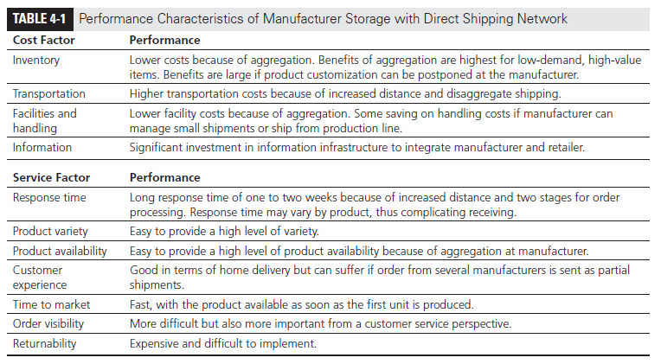
customer.
Table

Slide 12
3. Distributor Storage with Carrier Delivery
Under this option, inventory is held not by manufacturers at the factories, but by distributors/ retailers in intermediate warehouses, and package carriers are used to transport products from the intermediate location to the final customer.

Slide 13
4. Distributor Storage with Last-Mile Delivery
Last-mile delivery refers to the distributor/retailer delivering the product to the customer’s home instead of using a package carrier.
The automotive spare parts industry is one in which distributor storage with last-mile delivery is the dominant model. It is too expen­sive for dealers to carry all spare parts in inventory. Thus, original equipment manufacturers (OEMs) tend to carry most spare parts at a local distribution center typically located no more than a couple of hours’ drive from their dealers and often managed by a third party. The local distribution center is responsible for delivering needed parts to a set of dealers and makes multi­ple deliveries per day.

Slide 14
5. Manufacturer or Distributor Storage with Customer Pickup
In this approach, inventory is stored at the manufacturer or distributor warehouse, but customers place their orders online or on the phone and then travel to designated pickup points to collect their merchandise. Orders are shipped from the storage site to the pickup points as needed

Slide 15
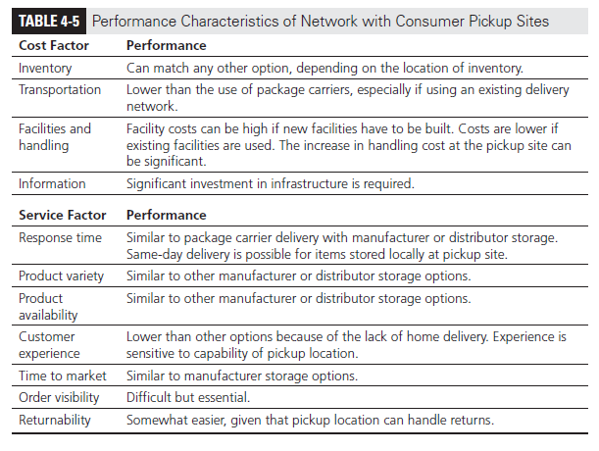
.

Slide 16
6. Retail Storage with Customer Pickup
In this option, often viewed as the most traditional type of supply chain, inventory is stored locally at retail stores. Customers walk into the retail store or place an order online or by phone and pick it up at the retail store.

Slide 17
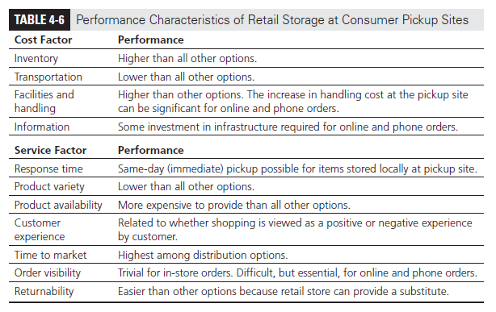
.

Slide 18
E-business and the Distribution Network:
E-business is a business model that conducts business transactions, activities and process through the internet.
E-commerce distribution channels are paths through which goods and services flow from producers to consumers through internet, web etc.
The primary purpose of a distribution channel is to make goods and services available to consumers most efficiently and effectively as possible. Your chances of getting a 5-star customer reviews increase as your distribution improves.
For example, suppose a manufacturer produces different types of chocolate products but doesn’t sell them directly to customers. In that case, he can work with distributors to get his product to the final customers. In this case, distributors can either be wholesalers, retailers, or both.

Slide 19
What Are The Two Methods Commonly Used to Distribute E-commerce Purchases to Customers
There are two main ecommerce distribution channels: direct and indirect.
Direct distribution channels involve selling products directly to consumers through brick-and-mortar stores or online via a website designed by a professional web design company.
Indirect distribution channels involve selling products to intermediaries, such as wholesalers or retailers, who then sell the products to consumers.

Slide 20
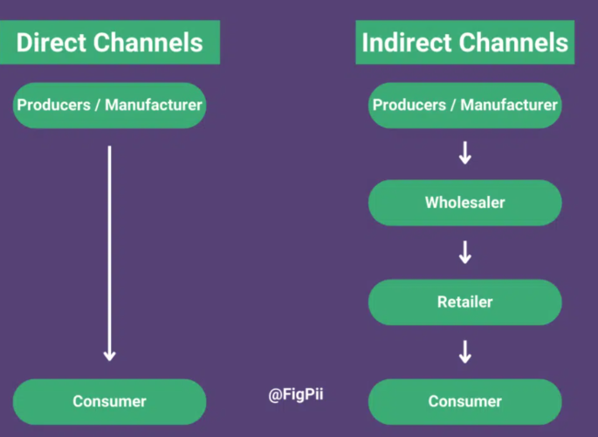

Slide 21
Impact of E-business on customer service:
Response time to customer
Product variety
Product availability
Customer experience
Faster time to market
Order visibility
Returnability
Direct sales to customer
Efficient funds transfer

Slide 22
What is customer service?
Customer service is the provision of service to customer before, during and after a purchase.

Slide 23
Why is facility location so important?
Facility location has a long-term impact.
Companies can locate anywhere in the world due to increased globalization, technology infrastructure, transportation, communications, &open markets,
Location still matters- clusters in many industries show that innovation & competition are geographically concentrated

Slide 24
THE ROLE OF NETWORK DESIGN IN THE SUPPLY CHAIN•
Network design decisions have a significant impact on performance because they determine the supply chain configuration and set constraints within which the other supply chain drivers can be used either to decrease supply chain cost or to increase responsiveness.
Facility location decisions have a long-term impact on a supply chain’s performance because it is very expensive to shut down a facility or move it to a different location.
In contrast, a poorly located facility makes it very difficult for a supply chain to perform close to the efficient frontier.
Capacity allocation decisions also have a significant impact on supply chain performance
Network design decisions must be revisited as a firm grows or when two companies merge.

Slide 25
Supply chain network design decisions include the assignment of facility role location of manufacturing storage , or transportation-related facilities, and the allocation of capacity and markets to each facility. It includes;
Facility role: what role should each facility play? What processes are performed at each facility?
Facility location: where should facilities be located?
Capacity allocation: How much capacity should be allocated to each facility?
Market and supply allocation: what markets should each facility serve? Which supply chain sources should feed each facility?

Slide 26
FACTORS INFLUENCING NETWORK DESIGN DECISIONS
STRATEGIC FACTORS:
A firm’s competitive strategy has a significant impact on network design decisions within the supply chain
Firms that focus on responsiveness tend to locate facilities closer to the market and may select a high-cost location if this choice allows the firm to react quickly to changing market needs.
For example, local capacity allows the company to respond quickly to changing fashion trends in Europe.
Convenience store chains aim to provide easy access to customers as part of their competitive strategy

Slide 27
Global supply chain networks can best support their strategic objectives with facilities in different countries playing different roles.
It is important for a firm to identify the mission or strategic role of each facility when designing its global network.

Slide 28
Offshore facility:
low-cost facility for export production. Role of being a low-cost supply source for markets located outside the country where the facility is located.
Source facility:
low-cost facility for global production. A source facility also has low cost as its primary objective, but its strategic role is broader than that of an offshore facility. Good offshore facilities migrate over time into source facilities.
Server facility:
Regional production facility. A server facility’s objective is to supply the market where it is located.
Contributor facility:
Regional production facility with development skills. A contribution facility serves the market where it is located but also assumes responsibility for product customization, process improvements, product modifications, or product development.

Slide 29
TECHNOLOGICAL FACTORS
Characteristics of available production technologies have a significant impact on network design decisions. If production technology displays significant economics of scale, a few high-capacity locations are most effective. As a result most semiconductor companies build few high capacity facilities.
For example, bottling plants for Coca-Cola do not have a very high fixed cost.
Flexibility of the production technology affects the degree of consolidation that can be achieved in the network. If the production technology is very inflexible and product requirements vary from one country to another, firm has to set up local factories

Slide 30
MACROECONOMICS FACTORS
Macro economic factors include taxes, tariffs, exchange rates and other economic factors that are not internal to an individual firm.
As trade increase and marketing become more global, macroeconomic factors have had a significant influence on the success or failure of supply chain networks.
Thus, it is imperative that firms take these factors into account when making decision.
MACROECONOMICS FACTORS
Tariffs and Tax Incentives
Tariffs have a strong influence on location decisions within a supply chain.For global firms, a decrease in tariffs has led to a decrease in the number ofmanufacturing facilities and an increase in the capacity of each facility built.

Slide 31
Taxes/ Tariffs:
Several levels of government must be considered when evaluating potential locations.
Countries with high tariffs discourage companies from importing goods into the country.
High tariffs encourage multinational corporations to set up factories to produce locally.
Many countries have set up foreign trade zones (FTZs) where materials are imported duty-free as long as the imports are used as inputs to production of goods.

Slide 32
Exchange rate and demand risk:
Fluctuations in exchange rates are common and have a significant impact on the profits of any supply chain serving global markets
Exchange rate risks may be handled using financial instruments that limit, or hedge against, the loss due to fluctuations.
Companies must also take into account fluctuations in demand caused by changes in the economies of different countries

Slide 33
POLITICAL FACTORS
Countries with independent and clear legal systems allow firm to feel that they have recourse in the courts should they need it.
INFRASTRUCTURE FACTORS
Poor infrastructure adds to the cost of doing business from a given location. Key infrastructure elements to be considered during network design include availability of sites, labor availability, proximity to transportation terminals, rail service, proximity to airports and seaports, highway access, congestion, and local utilities. What else?
COMPETITIVE FACTORS
Companies must consider competitors strategy, size and location when designing their supply chain networks. A fundamentals decision firms make is whether to locate their facilities close to competition or far from them.

Slide 34
CUSTOMER RESPONSE TIME AND LOCAL PRESENCE
It is thus best for a convenience store chain to have many stores distributed in an area so that most people have a convenience store close to them.
Most towns have fewer supermarkets than convenience store.
CUSTOMER RESPONSE TIME AND LOCAL PRESENCE
•
It is thus best for a convenience store chain to have many stores distributed in an area so that mostpeople have a convenience store close to them.
•
Most towns have fewer supermarkets than convenience stores.

Slide 35
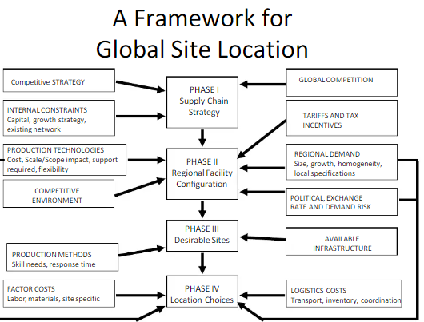
A Frame work for Network Design Decision
:

Slide 36
Phase 1: Define a supply chain strategy:
The objective of first phase of network design is to define a firms supply chain strategy. The supply chain strategy specifies what capabilities the supply chain network must have to support a firms competitive strategy.
Next the manager must forecast the likely evolution of global competition and whether competitors in each market will be local or global players.
Manager must also identify constraints on available capital and whether growth will be accomplished by acquiring existing facilities, building new facilities or partnering.

Slide 37
Phase 2: Define the Regional facility configuration:
The objective of the second phase of network design is to identify regions where facilities will be located, their potential roles, and their approximate capacity
Homogenous requirements favor large consolidated facilities, whereas requirements that vary across countries favor smaller, localized facilities
The next step is for managers to identify whether economies of scale or scope can play a significant role in reducing costs, given available production technologies
The regional configuration defines the approximate number of facilities in the network, regions where facilities will be set up, and whether a facility will produce all products fora given market or a few products for all markets in the network

Slide 38
Phase 3: Select the Desirable Sites:
Sites should be selected based on an analysis of infrastructure availability to support the desired production methodologies.
Hard infrastructure requirements include the availability of suppliers ,transportation services, communication, utilities and warehousing infrastructure, soft infrastructure requirements include the availability of skilled workforce, workforce turnover and the community receptivity to business and industry.

Slide 39
Phase 4: Location choices:
The objective of Phase IV is to select a precise location and capacity allocation for each facility.
The network design to maximize total profits taking into account the expected margins and demand in each market, various logistics and facility costs and the taxes and tariffs at each location.

Slide 40
Network Optimization Model :
This model is a business strategy that is used to maximize the efficiency of a company’s network. It involves the use of advanced algorithms and mathematical models to identify and analyze the most efficient ways to utilize the network resources.
The model helps to identify areas of inefficiency and make changes to the network architecture to improve performance. It also helps to identify the best practices for network security, reliability, and scalability.
By using the Network Optimization Model, businesses can ensure that their networks are running as efficiently as possible and that they are taking full advantage of their resources.
Additionally, the model can help to identify potential risks and vulnerabilities in the network, allowing businesses to take the necessary steps to protect their data and networks.

Slide 41
Capacitated Plant Location Model:
The capacitated plant location model is a mathematical optimization framework used in operations research and logistics to determine the optimal locations for facilities (plants) while considering capacity constraints. The objective is to minimize the total cost of establishing and operating these facilities while satisfying the demand requirements of customers.
Equation: Minimize ∑i​ ∑j​ cij ​yij​+ ∑i​ fi​x
In this equation:
cij​ represents the cost of serving customer j from facility i.
yij​ indicates the amount of demand from customer j served by facility i.
fi​ is the fixed cost of establishing a facility at location i.
xi​ is a binary variable indicating whether to establish a facility at location i.

